Slide 1
PERFORMX
Employee Performance & Rewards
Team Members
Student 1: 2600031244 – N . Lakshmana Rao
Student 2: 2600031203 – A . Vennela
Student 3: 2600031499 – Ch . Durga Sri Sandhya
Student 4: 2600031466 – P . Dinesh Reddy
Group Project 5 | Section: 09 | Academic Year: 2026-27
Faculty Mentor
Dr. D . Anand
https://kluniversityin-my.sharepoint.com/:p:/g/personal/2600031466_kluniversity_in/IQCfctLchSXYS7SpmQ82RomJAe84wf29Uw8fjc5p_0EBzYg?e=toBVvM

Slide 2
Technologies & Concepts Used
Development Stack
Core Java Concepts
Data Structures
Language: Java
Platform: Console / Desktop
IDE: Eclipse / IntelliJ / VS Code
Data storage: File Handling
Classes, Objects, Inheritance
Encapsulation, Polymorphism
Exception Handling
Lambda Expressions
Java Collections (List, Map)
Stream API
Searching and Sorting
Record Processing & Validation

Slide 3
1. Project Overview
PerformX automates employee performance evaluation and reward management.
Problem Statement
Project Objectives
Manual management of employee records is time-consuming.
Tracking attendance and performance accurately is difficult.
Reward allocation may lack transparency and consistency.
Generating reports requires significant manual effort.
Organizations need an automated system to improve efficiency and decision-making.
Develop an automated system to manage employee records efficiently.
Track and monitor employee attendance accurately.
Evaluate employee performance using a structured grading system.
Assign rewards and bonuses based on performance metrics.
Generate reports and analytics for informed decision-making.
Reduce manual effort and improve organizational transparency

Slide 4
2. Users and Functional Modules
Ten modules as defined in the PerformX specification.
Admin / HR
Core Modules
Service Modules
Register & update employees
Manage departments
Record attendance & scores
Employee
Department
Attendance
Performance
Reward
ValidateService
SearchService
ReportGenerationService
AnalysisService
Main (menu driver)
Manager / Employee
View performance & rewards
Search records
Receive reports

Slide 5
3. SDLC Approach for PerformX
A sample lifecycle for planning, building and maintaining the system.
01
Planning
02
Requirements
03
System Design
Identify project requirements
Define project scope
Select technologies (Java, OOP)
Assign team responsibilities
Prepare development schedule
Design system architecture.
Define modules such as Employee
Attendance, Performance, Reward,
and Reports.
Capture employee, attendance, performance, reward and report needs.
04
Implementation
05
Testing
06
Deployment & Maintenance
Develop Java classes, validations, searches and reports.
Verify each module individually.
Check calculations, validations, and report generation.
Run the system in the target environment.
Configure JDK and IDE setup

Slide 6
4. Requirements Analysis
Functional requirements derived from the PerformX modules.
Functional Requirements
Quality and Validation Needs
Employee: register, update, display details.
Department: add, update, assign employees.
Attendance: record days and calculate percentage.
Performance: compute score and assign grade.
Reward: calculate bonus and assign reward.
Search & reports: by ID, name, department.
Validate employee ID, name and email.
Validate appraisal score range.
Clear messages for invalid input or missing records.
Reusable service methods to avoid duplicate logic.
Readable reports for HR review.

Slide 7
5. System Architecture / Data Flow
High-level flow of the PerformX application.
PERFORMX
Main Module (menu)
ADMIN / HR
Input data
Reports
EMPLOYEE / MANAGER
Employee
Department
Attendance
Performance
Reward
Search / Report / Analysis
Data stores / files: employees.dat • departments.dat • attendance.dat • performance.dat • rewards.dat

Slide 8
6. Class Design
Main entities and services as per the PerformX specification.
Employee
Department
Attendance
employeeId, employeeName, department, designation, email
registerEmployee(), updateEmployee(), displayEmployee()
departmentId, departmentName, managerName, employeeCount
addDepartment(), updateDepartment(), assignEmployee()
employeeId, month, workingDays, presentDays
markAttendance(), calculateAttendance(), checkEligibility()
Performance
Reward
Services
performanceId, employeeId, appraisalScore, projectRating, performanceGrade
calculatePerformance(), assignPerformanceGrade()
rewardId, employeeId, rewardType, bonusAmount, rewardDate
calculateBonus(), assignReward(), displayReward()
ValidateService, SearchService, ReportGenerationService, AnalysisService
validate*(), search*(), generate*Report(), findBestEmployee()

Slide 9
7. Data Storage and Persistence
Flat files store records using Java File Handling.
File | Data stored | Used by
employees.dat | Employee records | Employee / Search
departments.dat | Department records | Department / Analysis
attendance.dat | Attendance records | Attendance / Reports
performance.dat | Performance records | Performance / Analysis
rewards.dat | Reward records | Reward / Reports
Records are loaded into ArrayList / Map collections at start-up and saved back on exit.

Slide 10
8. Testing Strategy
Example test areas for validating PerformX modules.
Employee registration
Valid / duplicate ID; invalid email
Saved, or clear validation message
Attendance
Present > working days; zero working days
Correct percentage or handled edge case
Performance
Score at boundaries; invalid score
Correct score and grade
Reward
Eligible / non-eligible employee
Correct bonus or no reward
Search
Existing and non-existing ID / name
Matching record or “not found”
File handling
Missing, empty or malformed file
Controlled error; no data loss

Slide 11
9. Expected Outcomes and Future Enhancements
Expected Outcomes
Possible Future Enhancements
Centralized employee, attendance and performance records.
Consistent, data-based performance grading.
Transparent reward and bonus allocation.
Quick identification of top performers.
Structured reports for HR decisions.
Database integration instead of flat files.
Role-based login for HR, managers and employees.
Web or GUI dashboard with charts.
Downloadable PDF / Excel reports.
Email notifications for rewards.

Slide 12
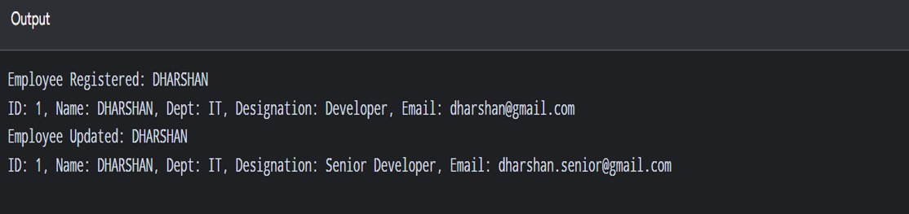
10. Sample Outputs
Replace the boxes below with your console screenshots.
Add employee
Attendance %
Performance grade
Reward report
Analysis summary

Slide 13
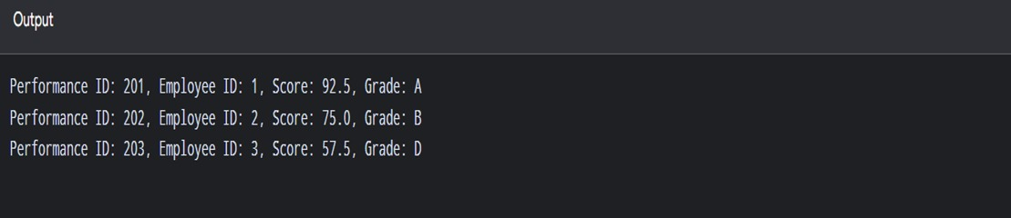
Grade

Slide 14
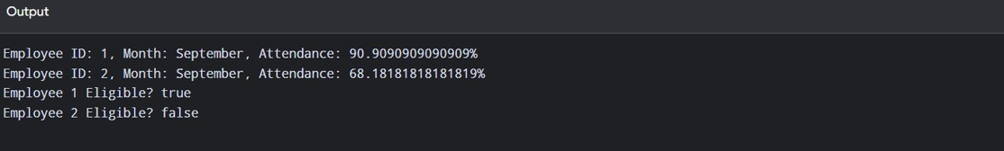
Attendence

Slide 15
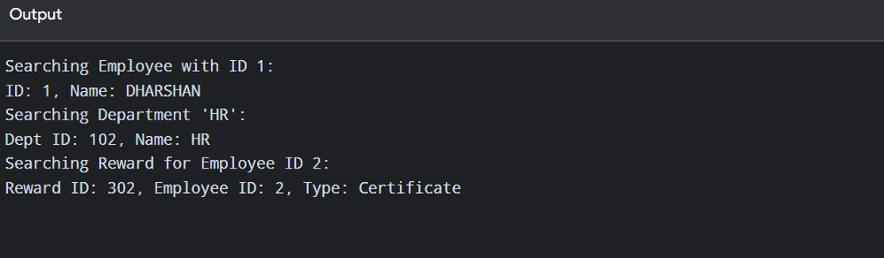
Search module

Slide 16
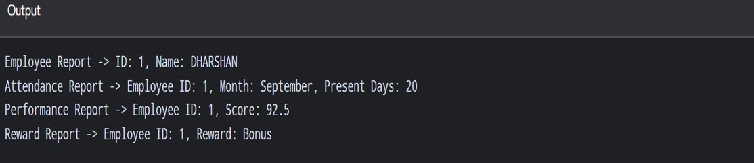
Report

Slide 17
THANK YOU
PerformX – Employee Performance & Rewards
Questions & Answers

